Slide 1
Notes:
In the last video we developed the machinery for building logistic regression models that can use any number of features to distinguish between two classes of items.
However most of the interesting problems in the world involve more than two types of things.
For example we can think about
+ recognizing handwritten digits
+ predicting customer satisfaction
+ credit scoring
and many others in medicine, engineering, business, etc.
In this video we will complete the picture of logistic regression by extending our techniques to problems involving more than two classes

Slide 2
Three approaches
One-vs-rest
One-vs-one
Multinomial regression
Notes:
We will cover 3 methods for adapting binary classification models to multi-class problems.
The first two: one-vs-rest and one-vs-one are generic and can be used with other classification models, aside from logistic regression.
One-vs-rest classification requires that the underlying binary classification model must return a continuous probability for the prediction, not simply a binary class assignment.
One-vs-one classification does not have this requirement. It can be used to extend any binary classifier to multi-class problems.
The last approach, multinomial regression, is a generalization of logistic regression to the multi-class case.

Slide 3
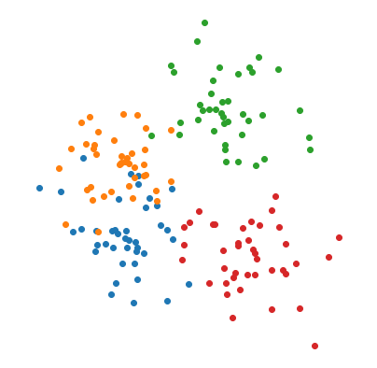

Notes:
To illustrate, we will use a 2-dimensional problem with 4 classes.
We will use a capital letter K to denote the number of classes. So in this case, K=4.

Slide 4
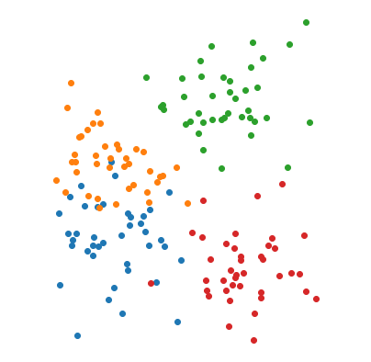
One-vs-rest
Notes:
The one-vs-rest or OVR strategy uses a binary classifier to build K separate models, each one pitting one class against all of the others.

Slide 5
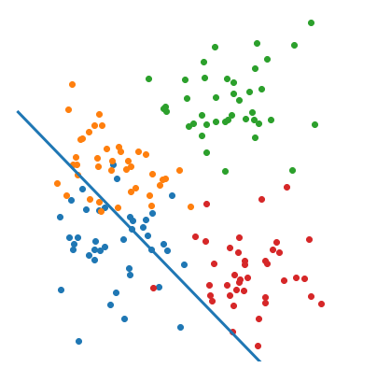
Class 1 vs. rest :
Notes:
The first of these classifiers would be trained to distinguish class 1 from all other classes. Here we show the decision boundary for that model.
But what we will actually use from the model is the continuous valued probability of class 1 as a function of x. If the binary classifier is logistic regression, then this will be a logistic function which we denote by sigma 1 of x.

Slide 6
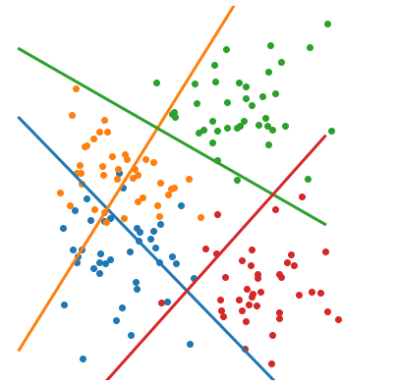
Notes:
The one-vs-rest model consists of the K separate binary classifiers.
To predict the class of a new data point, shown here in green, we simply evaluate each of the binary classifiers and select the one that produces the largest value.
That is, we select the class that the point x is most likely to belong to according to this set of binary classifiers.

Slide 7
Notes:
Here we see the class regions that result from the one-vs-rest approach. Note that the boundaries are linear despite the fact that they were obtained by taking the maximum over sigmoid functions. The one-vs-rest multi-class classifier is therefore a linear classifier.

Slide 8
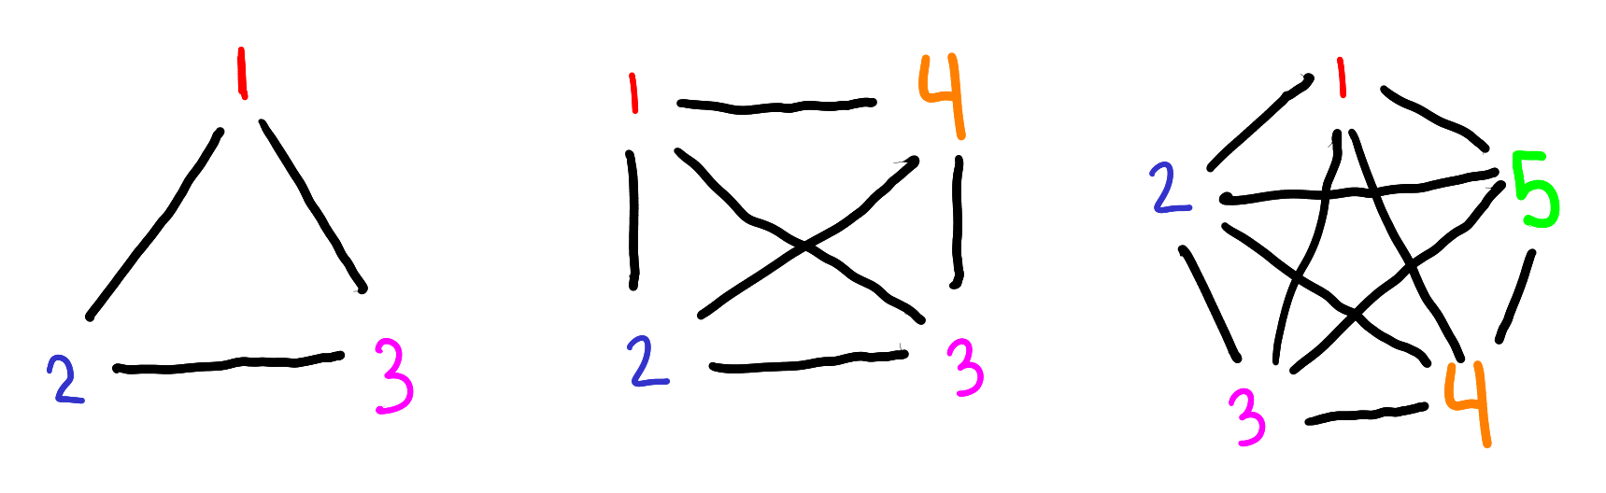
One-vs-one
Notes:
The ovr approach made use of the probability estimate generated by the binary classifier.
However not all binary classifiers produce a probability estimate. The perceptron, for example, generates a decision boundary, but no probability estimate.
For this type of classifier, we can use the one-vs-one approach.
In one-vs-one, we run the binary classifier on every pair of classes. So if we have 3 classes we run 1-vs-2, 1-vs-3 and 2-vs-3.
The total number of executions of the binary classifier is K*(K-1)/2.
So for four classes we must construct 4*3/2 = 6 binary models
for 5 classes we must build 5*4/2 = 10 models, etc.

Slide 9
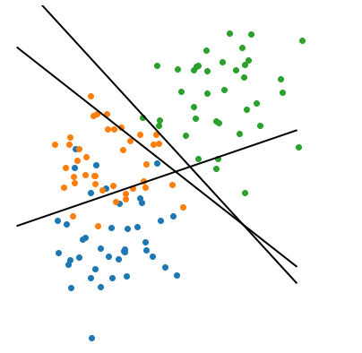

Notes:
We will focus for now on the simpler case of 3 classes.
The decision boundaries for the 3 binary classifiers are shown.
To classify a new data point, we evaluate all three binary classifiers and decide by majority vote.
In this case, the green sample is regarded as class 3 by two of the models, and as class 1 by the other. Hence it is predicted to be of class 3.

Slide 10
Notes:
These are the class regions created with one-vs-one.
The boundaries of these regions are boundaries of the binary classifiers. Thus we can conclude that, if the binary classifiers are linear, then the one-vs-one extension will also be linear.
Note though that there is a problem with this picture. The region in the middle is not shaded. This is because the voting in this region resulted in a 3-way tie amongst all of the classes, so the data could not be classified. This is a drawback of the one-vs-one approach.

Slide 11
One-vs-one
One-vs-rest
Linear in K
Data imbalance
Probability required
All points classified
Quadratic in K
Balanced data
Probability not required
Some points may not be classified
Notes:
Here are a few pros and cons of these two strategies.
One-vs-rest has the advantage over one-vs-one that the number of models that need to be trained grows linearly with the number of classes, as opposed to quadratically with one-vs-one.
However the size of the training problems is smaller in one-vs-one by an factor of K-1.
Furthermore each of the model training runs in one-vs-one involves data from a single class at a time, and so the data sets are likely to be more balanced between positive and negative samples than with one-vs-rest.
As we saw, one-vs rest is only possible if the binary classifier returns a probability, whereas one-vs-one can always be used.
And finally one-vs-one has the drawback that it may not be able to classify some data points for which there is no unique winner in the voting process, whereas one-vs-rest does not have this problem.

Slide 12



Notes:
Next we will talk about multinomial regression, which is our most general form of logistic regression.
Multinomial regression is similar to one-vs-rest in that we will calculate a continuous probability for each class, and it is similar to one-vs-one in that each of the models will be trained by comparing one class to just one other.
The derivation begins by specifying a reference class to which all other classes will be compared. We will use class K as the reference, however the result would be the same with any other selection.
Next we build K-1 logistic regression models by comparing each of classes 1 through K-1 to the reference class K.
Let’s begin with the model 1 vs. K.
The trained coefficients beta 1,0 through beta 1,m combine linearly with the features to produce the log odds, which is the logarithm of the probability of class 1 over the probability of class K.
To make the notation simpler, let’s define a vector beta 1 of coefficients for this model and denote the linear combination as negative beta 1 dot x.
Then we can do the same for classes two through K-1.

Slide 13
Notes:
From each of these we can express the probability of the class any kappa as the probability of class K times the exponential of negative beta dot x.
Here kappa is any class 1 to K-1

Slide 14

Notes:
Next we observe that, because the class probabilities must add up to 1, the probability of class K equals 1 minus the sum of probabilities from 1 to K-1.
We can now pluguse in the expression for the probability of class kappa that we just derived and obtain:

Slide 15


Notes:
that the probability of class K equals 1 over 1 + the sum of the odds of all other classes.
Using this expression we get the probability of the other classes 1 through K-1, as the odds of that class divided by the same denominator.
These are the final formulas for multinomial logistic regression. They may seem complicated at first, but comparing them to the original logistic regression you will see that they are actually a very reasonable generalization.
Furthermore they have solved the problem of multi-class classification in a much more elegant way for logistic regression than was achieved with the generic approaches of one-versus-rest and one-vs-one, since we have obtained explicit formulas for the probabilities with only K-1 binary models.
That’s it for multi-class regression.
In the next video we will learn how to do all of this in code.

